Slide 1
Air Quality Machine Learning
Dustin, Michael, Arjun

Slide 2
Task at Hand
5 metal oxide sensors collect hourly data on air quality. The sensors were placed in a field in a town in Italy.
We are attempting to use the air quality data to predict absolute humidity.

Slide 3
Data Ingestion & Wrangling
Data Ingestion
This dataset was available for download from the UCI Machine Learning data repository.
We read the dataset into a pandas dataframe.
Data Wrangling
Missing values were represented with -200.0 in the dataset. We replaced these values with numpy.nan and then replaced all nan values with the column mean using dataframe.fillna()
We converted the “Date” column to a “Day of Year” column and the “Time” column to an “Hour of Day” column.
We decided not to use “Relative Humidity” feature as we thought it represented leakage.

Slide 4
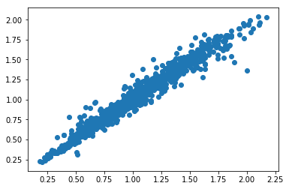
Machine Learning
Modeling
We split the data into training and test sets using sklearn.train_test_split (test size of 10%).
We fit three different models:
Lasso Regression: r^2 of 0.81
Ridge Regression: r^2 of 0.85
Random Forests: r^2 of 0.95
We then plotted our predicted values vs. the actual values on a scatter plot using matplotlib

Slide 5
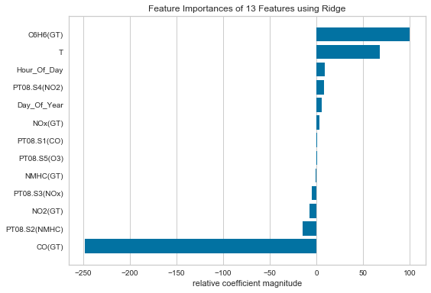
Yellowbrick Visualization - Ridge

Slide 6
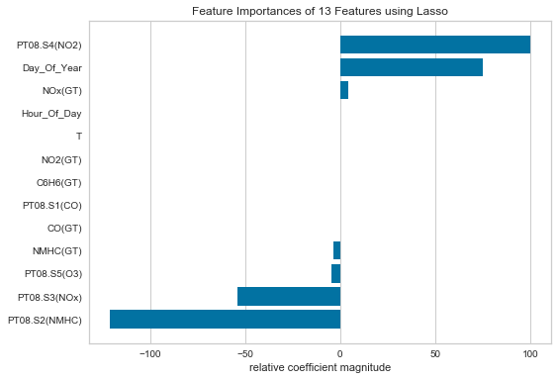
Yellowbrick Visualization - Lasso

Slide 7
Yellowbrick Visualization - RF

